Slide 1
e-Books: Reaching the incremental boater market
McGraw-Hill / USCG Auxiliary Seamanship Seminar Series
21 March 2015

Slide 2
Seamanship Seminar Series
What is it?
What is the strategy?
What is needed?
Why BS&S content?
How does it work?

Slide 3
What is it?
BS&S advanced chapters as stand-alone seminars
Teach one or a series of seminars
Students receive e-Books rather than printed texts
Recently updated PPT available
In E-Directorate’s eLib Resource Center

Slide 4
Goals
Capture the post-ABS graduate student so as to create synergy with existing PE programs while, at the same time, leveraging our reputation
Nearly 38,000 PE missions got underway in 2014
Very little was repeat business
A waste AND an opportunity
Notes:
Is this slide the strategy that Mark was looking for?

Slide 5
Strategy
Create an add-on electronic capability that leverages our existing content, i.e., low- or no-cost
Partnering with world- class publishers in the education or maritime markets
Resulting in revenue opportunities for units that can be invested back in further RBS capabilities
Notes:
Is this slide the strategy that Mark was looking for?

Slide 6
Features
Short seminar based classes
Text accessed via the Internet
Requires no printed inventory
Suitable for classroom presentation
Allows for flotilla income
Targets un-tapped boating market with previous positive USCG Aux PE experience
Meets market demand for high-tech solutions
Notes:
Is this slide the strategy that Mark was looking for?

Slide 7
What are the drivers?
Market: graduates of mandatory
courses are looking for more advanced
boater education; presenting an
opportunity for…
Flotilla revenue: Short seminars present the opportunity for revenue growth and that can give us much needed…
Instructor excitement: New seminars added to Public Education Library

Slide 8
Market size example
Connecticut
10,520 State course graduates
in 2014 alone
1,800 taught by USCG Auxiliary
10,778 taught by USCG Auxiliary in past 5 years
Natural market for incremental students

Slide 9
Why use BS&S chapters?
We own the material
Current illustrations can be easily updated
Subject matter has proven popularity
The least complicated market entry
No start-up cost
Shortest time frame
Notes:
Bullet 2 seems out of place. Not connecting to why use BS&S
Another level of tech support? Is this for MH?

Slide 10
Meatiest content selected
Inland Boating
Boating Safety
Powering Your Boat
Lines and Knots for Your Boat
Weather and Your Boat
Your Boat’s Radio
Navigation excluded –
covered now by Weekend Navigator,
and soon by Modern Marine Navigation

Slide 11
What about BS&S?
The present BS&S, with the printed textbook, may continue
to be taught as is.
NO CHANGE
Notes:
I would remove “as we know it”. Until this has some time to bake nothing from the old way will change.

Slide 12
How does it work?
Flotilla decides to offer Seminar(s)
Selects dates and venues
Establishes fees
Promotes seminars – use team approach
Order e-Book codes from AUXCEN
Receives codes within a day
Codes do not expire
Email code to student after payment made
Student opens a free BookShout account, enters code and views/downloads e-Book to their own device (e.g., PC, MAC, e-reader, smart phone)
Notes:
Is BS&S enhanced the MH project? If Yes then it should be called that on the title slide.
Is this the old presentation?

Slide 13
Financials
Students receive a code for each
chapter instead of a textbook
Codes are used to access e-Book
Flotilla pays $4.95 per code for an e-Book
Flotilla may charge students as appropriate

Slide 14
Example Seminar Financials
Flotilla has 10 students
Flotilla charges student $20
Flotilla purchases 10 codes @ $4.95
e-Book total costs 10 X $4.95 = $49.50
Seminar revenue: 10 X $20 = $200
Net revenue to flotilla = $150.50

Slide 15
Ordering e-Book Codes
Go to AUXCEN www.shopauxiliary.com
Click on “District Online Members Store”
Sign in or create an account
Under “Public Education” select
“e-Books – Seamanship Seminar Series”
Choose the Chapter(s) and quantity

Slide 16
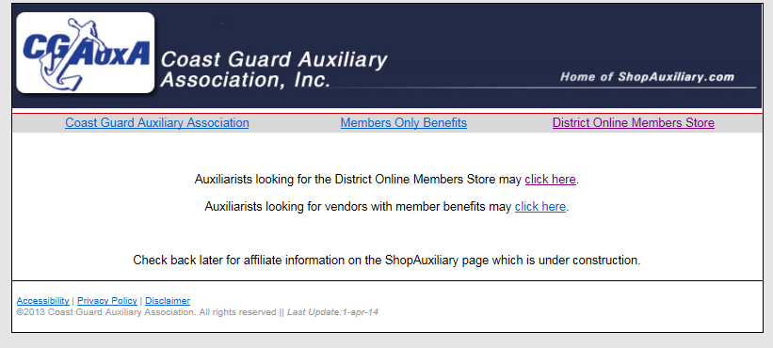

Slide 17
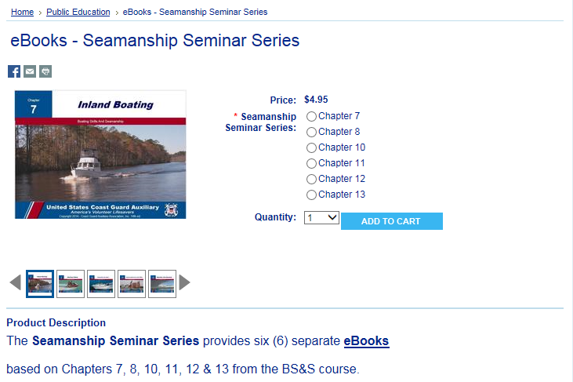
AUXCEN – e-Books for SSS

Slide 18
Ordering e-Book Codes (cont’d)
Proceed to Checkout - for Shipping Method, choose Ship to (your address)
Keep email confirmation for reimbursement
Receive email within a day that links to AUXCEN with hyperlinks with the codes.
Print page and/or cut and paste hyperlinks to a file for safe keeping

Slide 19
Code Administration
Hyperlinks (codes) are assets
https://bookshout.com/mhp-bss13?code=NNNNNNNNN1
Need to be tracked and managed
Order No: xxxxx
e-Book: BS&S Ch 13
Date Received: 16Mar2015

Slide 20
Assigning Codes to Students
Collect payment from student
Prepare an individual email to each student after payment from the student is received
Attach the Student Guide
Include hyperlink assigned to that student
Include class logistics and contact information
Record hyperlink assignment in code tracking table
Send message to student

Slide 21
Student Accesses e-Book
Establish BookShout account
www.BookShout.com
Hyperlink is automatically entered
Read on BookShout reader or download to device of choice

Slide 22
Student Accesses e-Book (cont’d)
Access e-Book while logged into
BookShout using BookShout reader
Applicable to PC or Mac
Requires connection to Internet
Download e-Book to device supporting BookShout APP
iOS (Apple mobile devices e.g., iPhone, iPad)
Android (e.g., smartphones, tablets)
Kindle Fire
Nook
Up to 5 downloads permitted

Slide 23
AuxData
Use PE Mission Code “Other” (14G) when completing 7030s

Slide 24
Support
Instructor Guide
Student Guide
Auxiliary Help
Forward questions via the Chain to DSO-PE
National Help Desk at www.cgaux.org
BookShout Help
Robust support at http://support.bookshout.com

Slide 25
Support continued
FAQs – Auxiliary-specific issues – in preparation
SSS-specific press release – in preparation
Articles - 20 newspaper-ready articles to attract boaters to our classes (on the E-Directorate website)
Best practices: Job #1 – RBS, our new RBS consolidated e-Magazine (availability imminent)
Teaching techniques
Marketing techniques that work
And more…
Notes:
Marketing plan?

Slide 26
What’s the timeline?
Reviewed at N-Train
Announced on 18 March
Seminars can now be offered
Notes:
Jan1 – what happens on this date?
Rollout of training?
Flotillas can start offering?

Slide 27
Questions

